Slide 1
Lecture 19:
Dalit and Green Politics in India - I
Course: Environment and Politics in India

Slide 2
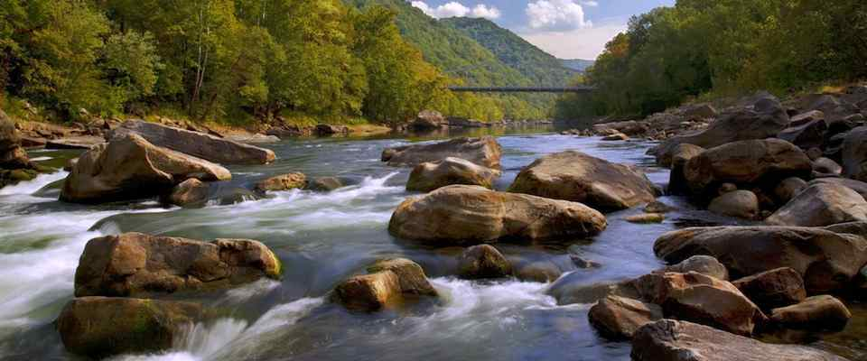

Slide 3
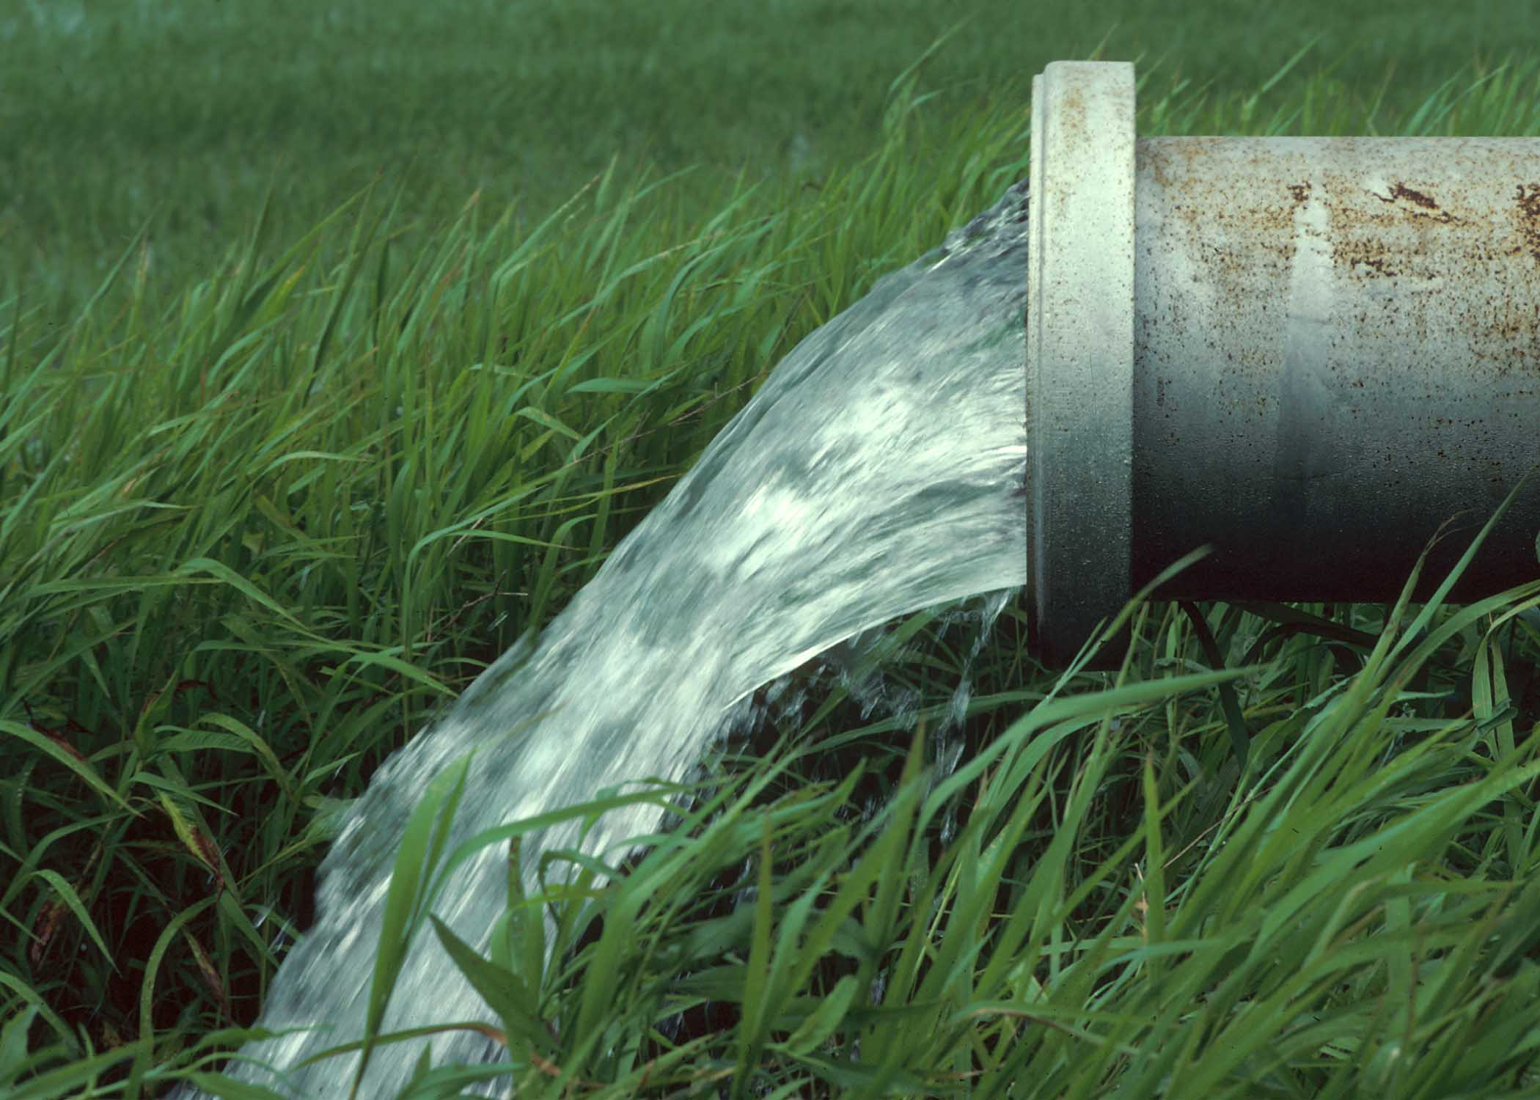

Slide 4
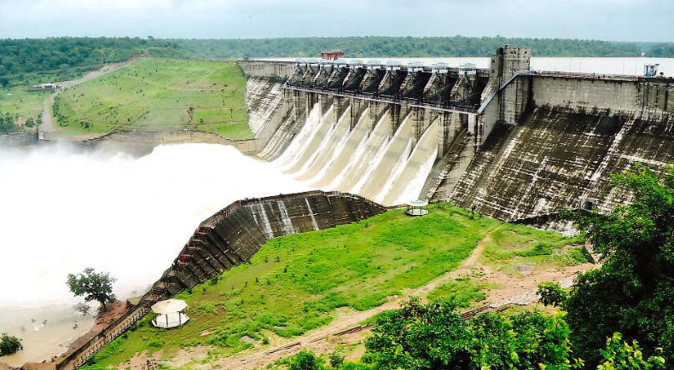

Slide 5
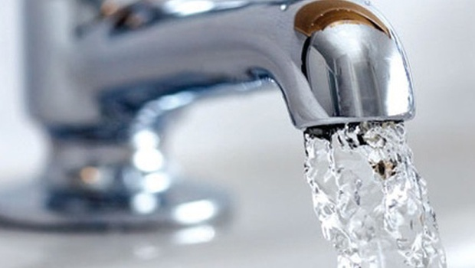

Slide 6
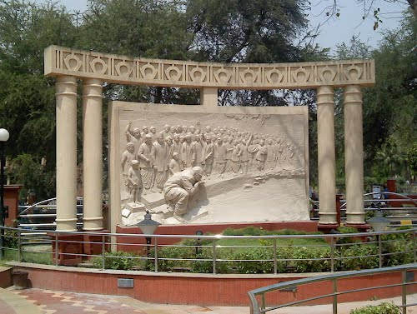

Slide 7
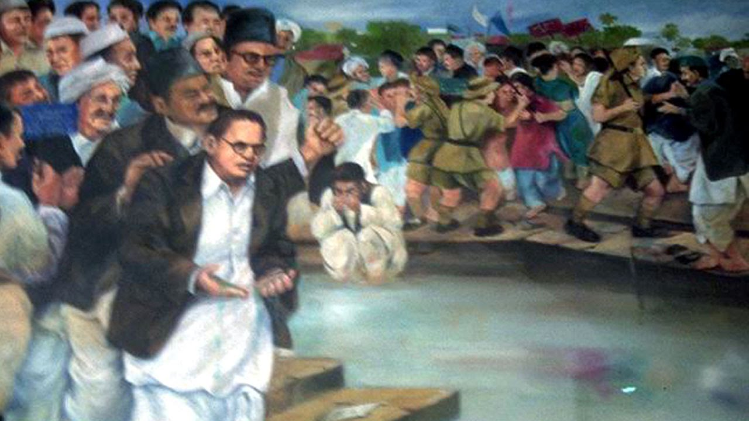

Slide 8
Different experiences with ‘nature’
WATER
As a ‘pure’, ‘pristine’, free flowing object
As a means to prosperity
As a symbol of humiliation/indignity/struggle
HOW can nature be framed?
As a ‘natural’, common good. NOT ‘social’ OR ‘POLITICAL’.
As a SOCIALLY/POLITICALLY CONSTRUCTED space.
Similarly, HOW can ‘village’ be framed?
Dominant model of Indian environmentalism: AGRARIANISM. Idea of grain-producing peasant societies with human-scale technology and STRONG community bonds. VILLAGE economy as an environmental ideal (NOT industrial/tribal).
As a space for strengthening CASTE hierarchies.

Slide 9
‘Eco-casteism’
HOW can ‘nature’/environment be used to strengthen caste?
Caste as part of a ‘NATURAL’, ‘ecological’ model, NOT a social construct.
Castes as NATURAL, ‘scientific’, ecological niches.
“The caste system … was actually based on an ancient concept of sustainable development which disciplined the society by partitioning the use of natural resources according to specific occupations; and “created” the right social milieu in which sustainable patterns of resource use were encouraged to “emerge”.
“The maintenance of the varna system is therefore the key element in the performance of the dharma. Given the criticality of this concept to the Brahminic system, it is interesting that this equilibrium structure appears to be derived from ecological foundations. Foundations that are readily revealed if we look at the varna equations as a trophic system” - Purnendu Kavoori (2002)

Slide 10
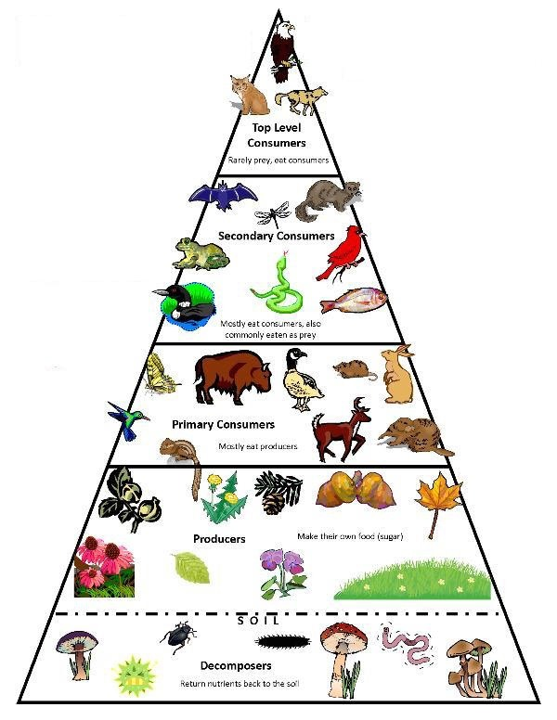
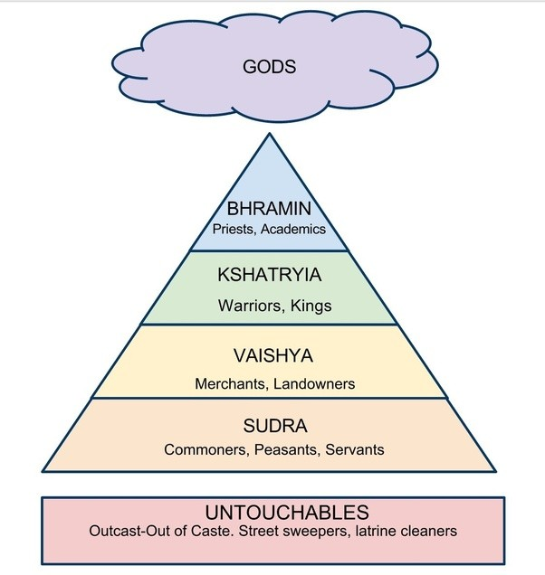

Slide 11
‘Eco-casteism’
“It is deeply provocative but nonetheless logical to hold that the evolution of untouchability was in a ecological sense something of the masterstroke which enhanced the competitive advantage of those populations that adopted it (i.e. on whom discrimination was imposed). Thus would have developed specialised population of decomposers, parasites, scavengers and so on. This in our view is the ecological rationale for the adaptive success of untouchability, the latent principle in the varna system” – Purnendu Kavoori (2002)
PROBLEMS?
How does only explain shifts in caste-based practices?
What about the CULTURAL aspects of caste? Purity/Pollution, Food taboos?
What about principles of equality/justice/rights/liberty?

Slide 12
‘Eco-organicism’
KEY terms/ideas:
NATION (‘pure’, ‘natural’, community)
CULTURE (diverse, BUT ‘natural’). Defined by family, rites, customs, faiths, rituals, ceremonies, social systems, values.
Western influence/Decline of ‘Indian’ thought
POLLUTION of mind, body, society
RESULTS?
Protection of the ‘environment’ = Protection of Indian culture, tradition, ‘nation’
ENEMIES: ‘Outsiders’, modernity, modern science, technological modernisation, secularism
Eco-organicism -> ECO-NATURALISM. NATURALISATION of SOCIAL/POLITICAL phenomena

Slide 13
Implications
WHAT are practical implications of eco-casteism/eco-naturalism/eco-organicism?
Debate between Gandhi and Ambedkar.
HOW to address ‘pollution’/sanitation/scavenging?
‘Ideal Bhangi’ versus ‘linking a degrading practice with ideals of service…outrage and cruel joke’.
Bindeshwar Pathak versus Bezwada Wilson. Addressing ecological (pollution)/sanitation question with/without the SOCIAL question of caste.
“Reforming caste”. Valourising of SOME Brahmins/Brahminical ‘virtues’/practices. Turning the Bhangi into a Brahmin, NOT finishing off the caste system. Not annihilation of caste, but UNITY of castes.

Slide 14
Dalit Environmental Visions
Some KEY points:
NEGATION of
    Caste as an ‘ecological model’
    Laws of ‘nature’ as a guiding principle for society/social relations
    Sanctity of the ‘natural’ order
  HIGHLIGHTING of :
    Labour/Bondage/Unfair Distribution of Labour Value
    Space/Differential Access
    Past/memory/sacrifice

